Slide 1

Prediction of India’s GDP Growth Rate
Developing a Predictive Model for
Economic Insight

Slide 2
Introduction
Importance of GDP Prediction:
Policymaking
Investment Decision
Economic Stability and Growth

Slide 3

Index
Facts
Reasons for choosing this topic
Problem Statement
Background
Objectives
Time Series
Methodology
Feature Selection
Machine Learning Model
Model Evaluation
Predicted vs Actual Analysis
Economic Trends of Projection
Data Distribution
Outlier Detection
Output Vs Practical
Nominal GDP
Annual Growtrh Analysis
Economic Forecast of 2035
Conclusion

Slide 4

Authors
Sai Teja Rayabarapu (Student ID: 11637122)
SaiTejaRayabarapu@my.unt.edu
Major: Information Science
Manaswini Kodela (Student ID: 11637117)
ManaswiniKodela@my.unt.edu
Major: Information Science
Vivek Raj Rampelli (Student ID: 11596805)
VivekRampelli@my.unt.edu
Major: Information Science
Nikhil Vamsi Gutti (Student ID:11588082)
NikhilVamsiGutti@my.unt.edu
Major: Data Science

Slide 5

Facts
India has experienced significant economic growth over the past few decades. Its GDP growth rate has averaged around 7% per year over the last two decades, making it one of the fastest-growing major economies in the world.
India recently overtook the UK economy and became the fifth largest economy now.
Indian Rupee is now going global as 18 countries have agreed to trade in Rupee.
India's growth rate was the second highest among G20 countries and almost twice the average for emerging market economies.

Slide 6
Reason for choosing this topic
Its usage in Practical life
Public Engagement
Knowledge and Interest in the Field of Indian Economy
Ability to use the prediction model of Data Analysis

Slide 7
Problem Statement
Develop a predictive model for forecasting the annual GDP growth rate of India based on historical economic data, socio-political factors, and external influences, with the goal of providing accurate and timely insights for policymakers, investors, and businesses to make informed decisions and contribute to the economic stability and growth of the nation.

Slide 8
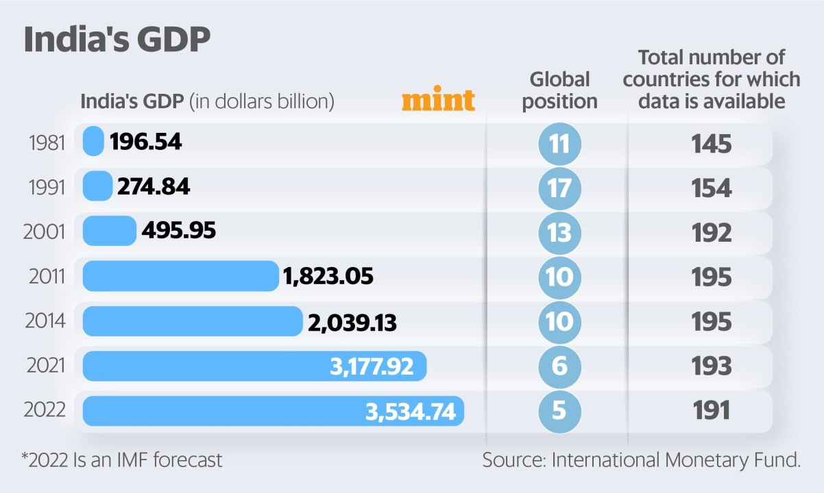
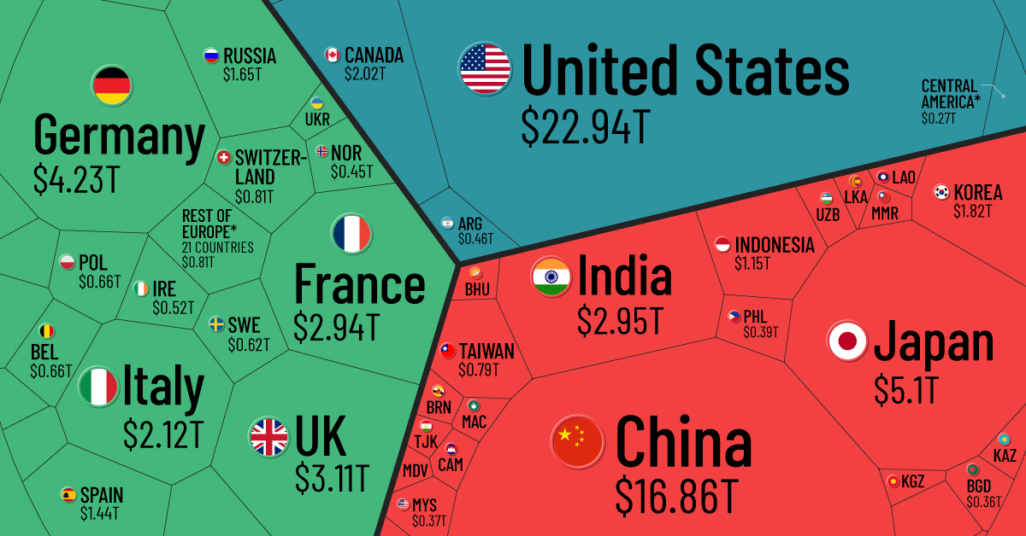
Background

Slide 9
Objectives
Accurate Forecasts
Timely Insights
Decision Support for Stake Holders

Slide 10
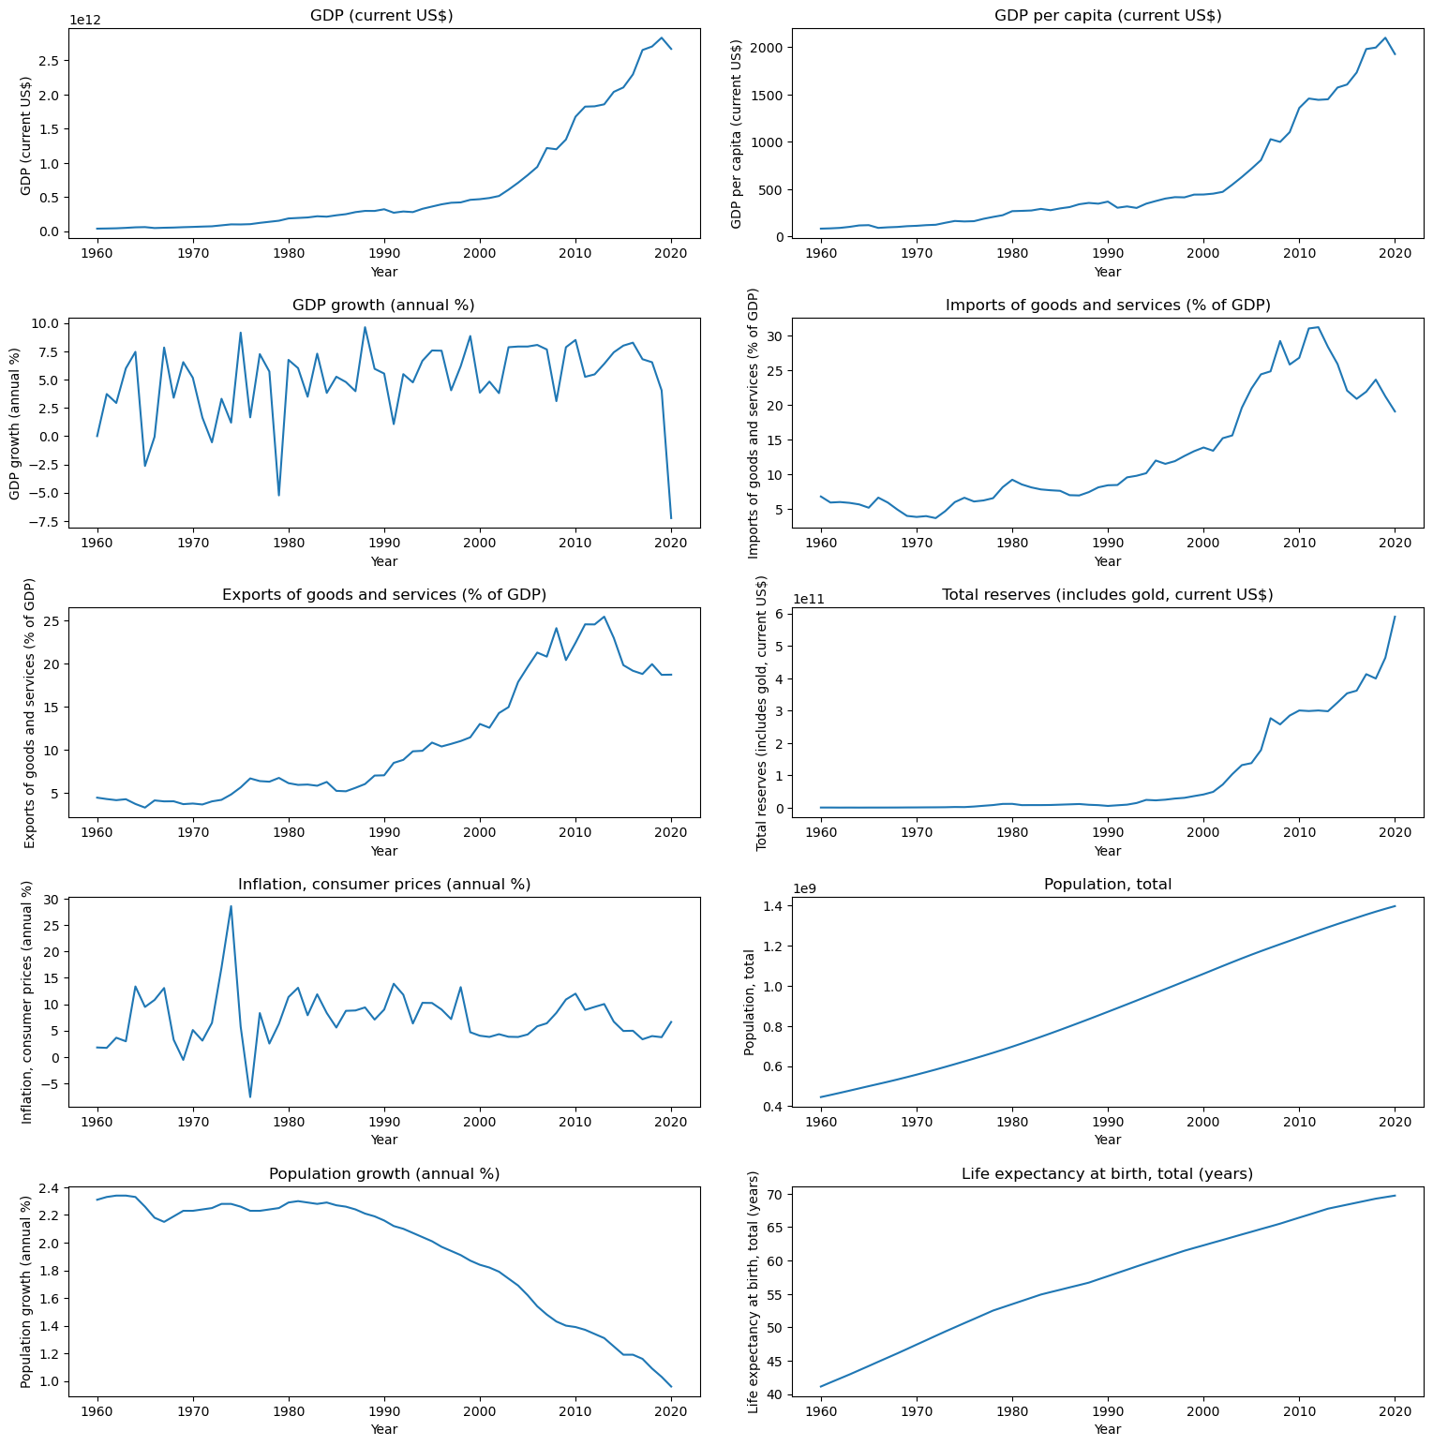
Time Series of Economic and Demographic Indicators

Slide 11
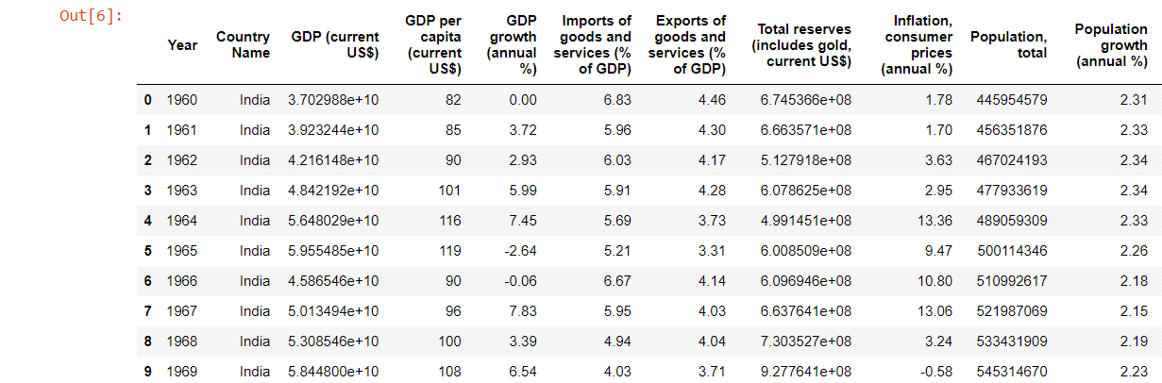
Methodology
1. Collecting historical economic data from credible sources.
2. Preprocessing the data to address any issues.

Slide 12
3. Selecting and engineering key features that influence GDP growth.
4. Using optimized machine learning algorithms, including time series methods, linear regression model for prediction.
5. Evaluating models using appropriate metrics and selecting the most accurate one.
6. Concluding with a report that presents insights, visualizations, and potential areas for further study or expansion.

Slide 13
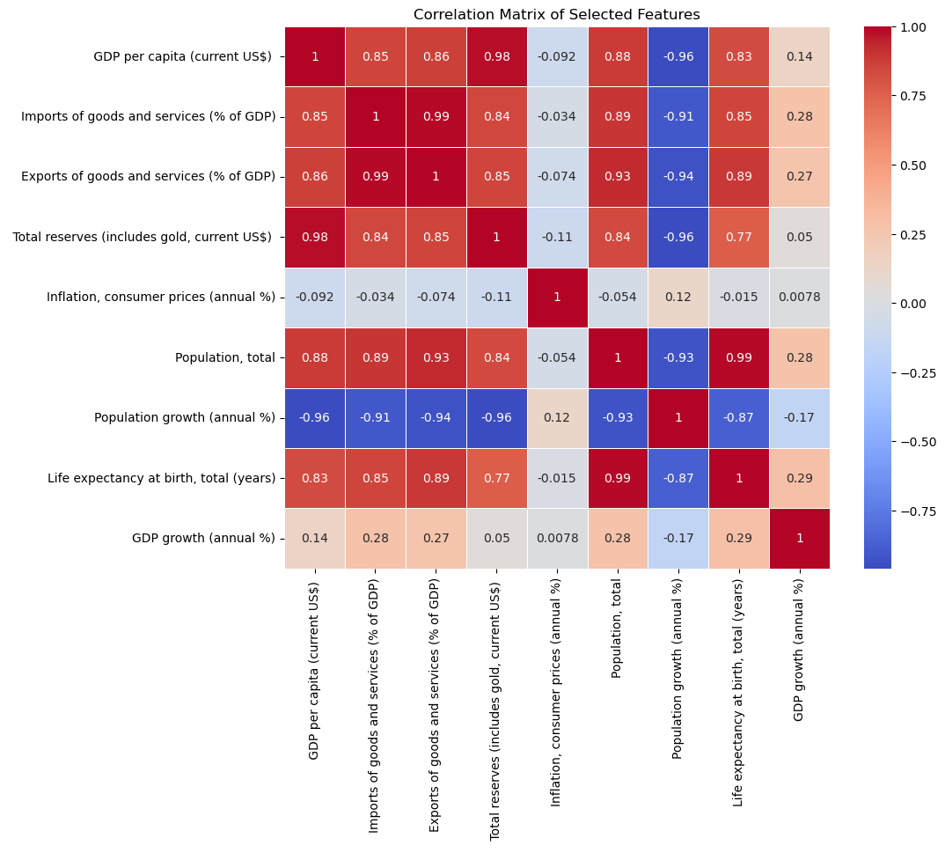
Feature Selection

Slide 14
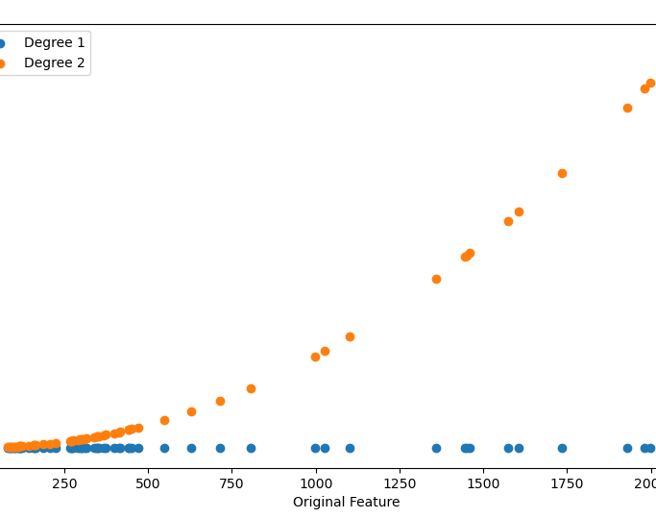
Machine Learning Model
Definition: Statistical method modeling the relationship between dependent variable (Y) and independent variable(s) (X).
Equation: �=�0+�1�1+�2�2+...+�Y=β0​+β1​X1​+β2​X2​+...+ε
Key Components: Y (Dependent Variable), X (Independent Variable), Coefficients (β₀, β₁, β₂, ...), Error Term (ε).
Types: Simple (one independent variable) vs. Multiple (two or more independent variables) Linear Regression.
Assumptions: Linearity, Independence, Homoscedasticity, Normality, No Multicollinearity.
How it Works: Trained on historical data to minimize the difference between predicted and actual values.
Evaluation Metrics: MSE, RMSE, MAE, R-squared for assessing prediction accuracy.
Use Cases: Predicting house prices, estimating sales based on advertising spending, etc.
Strengths and Weaknesses: Simple, interpretable, but assumes a linear relationship and sensitive to outliers.

Slide 15
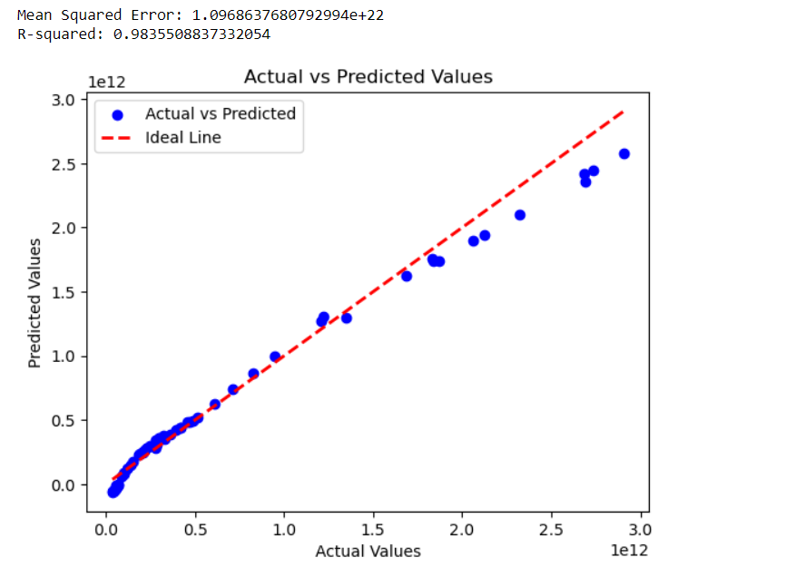
Model Evaluation

Slide 16
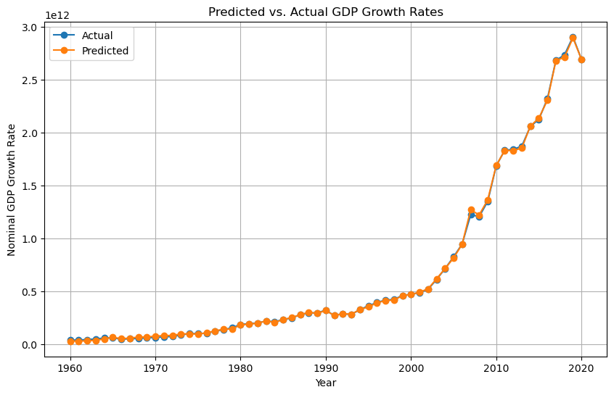
Predicted vs Actual Analysis

Slide 17
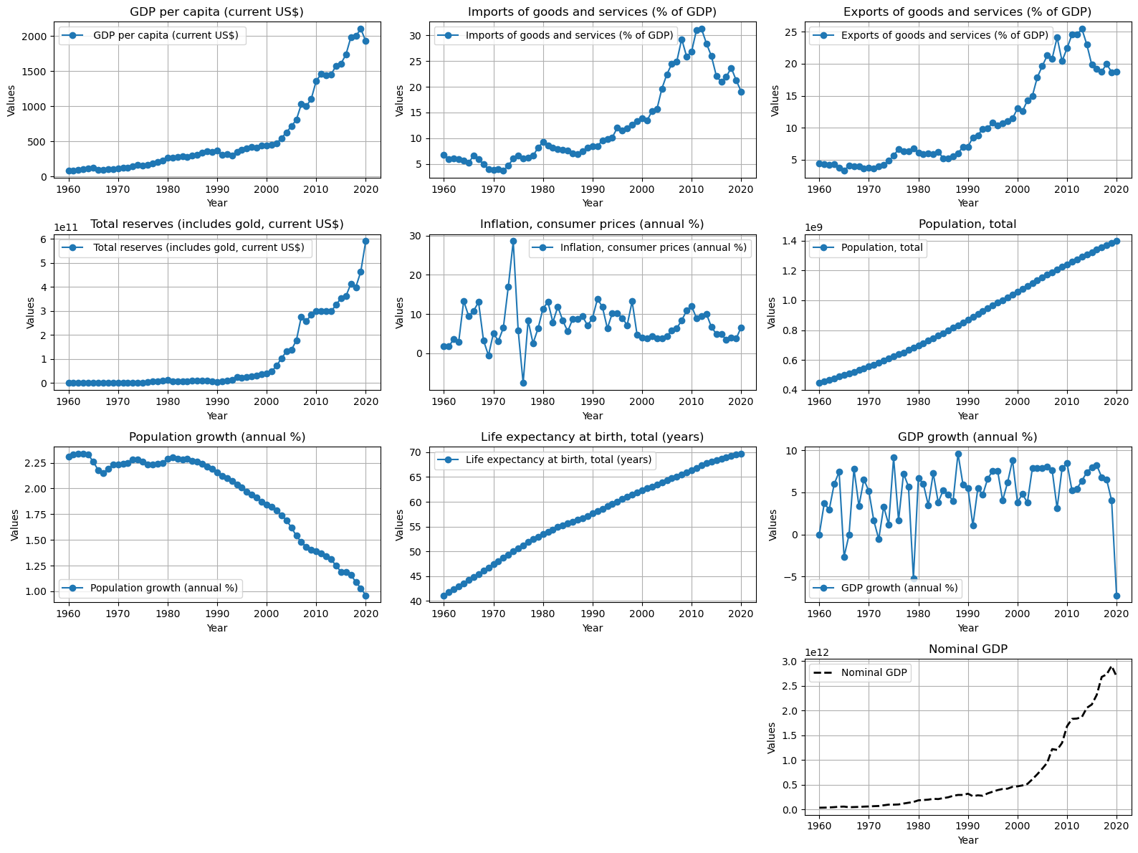
Economic Trends and Projections

Slide 18
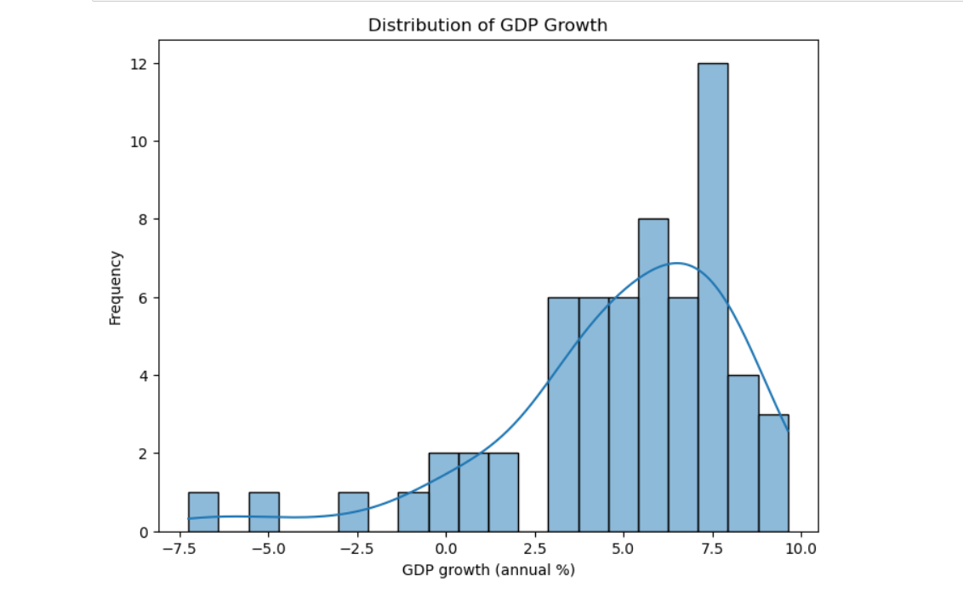
Data Distribution

Slide 19
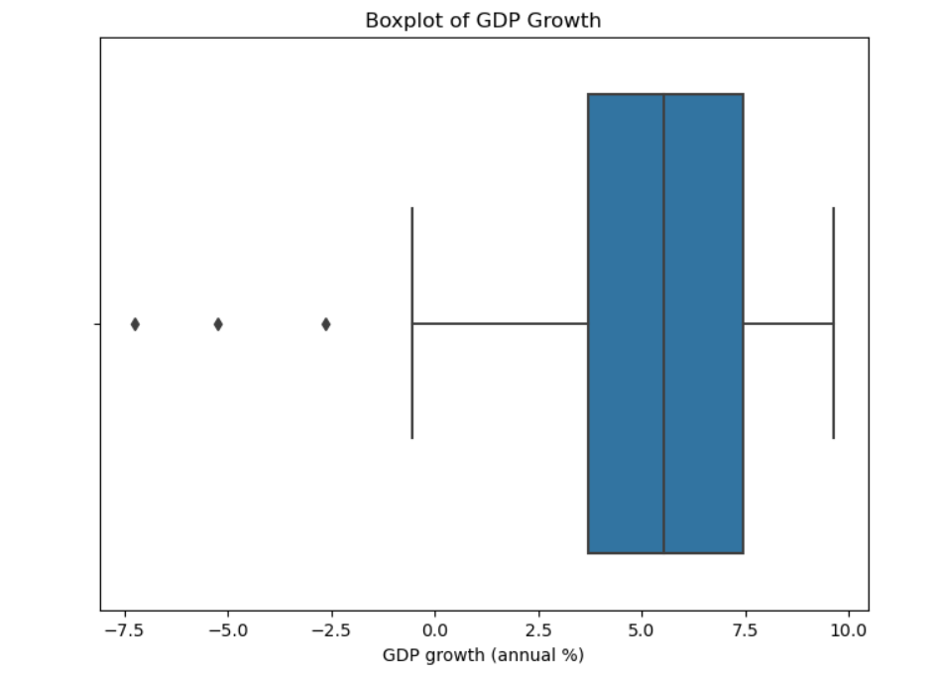
Outlier Detection and Handling (Boxplot):

Slide 20
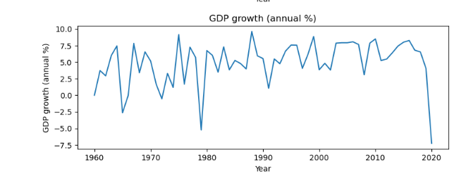
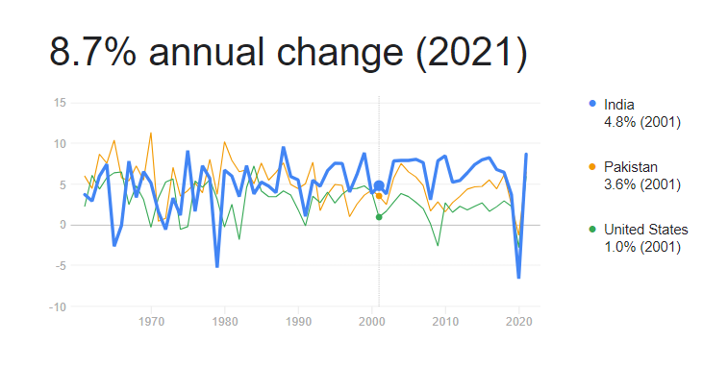
Output Vs Practical

Slide 21
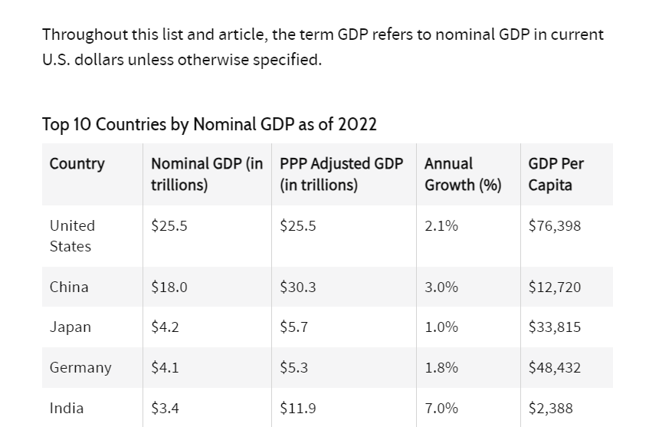
What is Nominal GDP
Nominal gross domestic product (GDP) is GDP given in current prices, without adjustment for inflation.

Slide 22
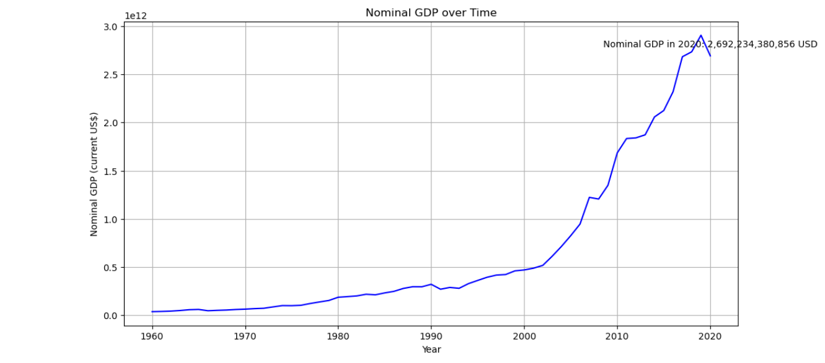
Nominal GDP

Slide 23
Group Insights: Annual Growth Rate Analysis
Data Preparation: As a team, we organized the dataset by sorting it chronologically and identified the initial and final values of the 'GDP per capita (current US$)' column for precise analysis.
Calculation Strategy: Collaboratively, we calculated the number of years covered by the dataset and applied the compound annual growth rate (CAGR) formula to assess the annual growth rate of the specified economic indicator.
Team Perspective: Our collective effort in computing the annual growth rate provides a comprehensive understanding of the historical trends in 'GDP per capita (current US$),' enabling the team to draw meaningful insights from the economic data.

Slide 24
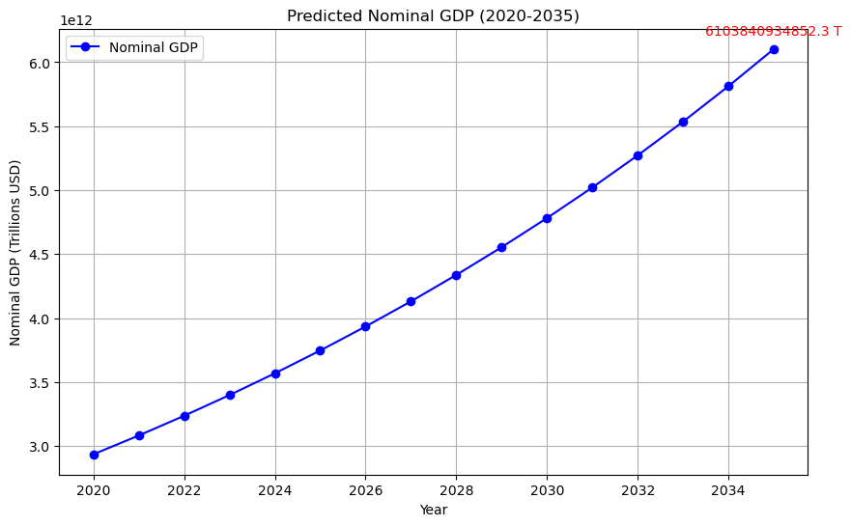
Economic Forecast for 2035

Slide 25

Conclusion
Our economic forecast for 2035, utilizing advanced modeling techniques and simulations, provides valuable insights into the potential trajectory of key economic indicators. The predicted Nominal GDP, based on a comprehensive set of features and a 5% annual growth simulation, offers a forward-looking perspective for strategic planning. The analysis underscores the importance of considering various factors such as GDP per capita, trade dynamics, reserves, and demographic indicators in shaping future economic outcomes. As we look ahead, these insights can serve as a foundation for informed decision-making, aiding policymakers and businesses in navigating and preparing for the economic landscape of 2035. The project demonstrates the power of data-driven forecasting in anticipating economic trends and informs proactive strategies for sustainable growth.

Slide 26

Thank you

